Slide 1


Python Programming language
Created by Group 2:
Jericko Chavez- 000885783
Justin Creig – 000997879
Nathan Romasanta – 000908010
Melody Shih - 000908455

Slide 2
Introduction
General purpose programming language
Simplicity and readability

Slide 3
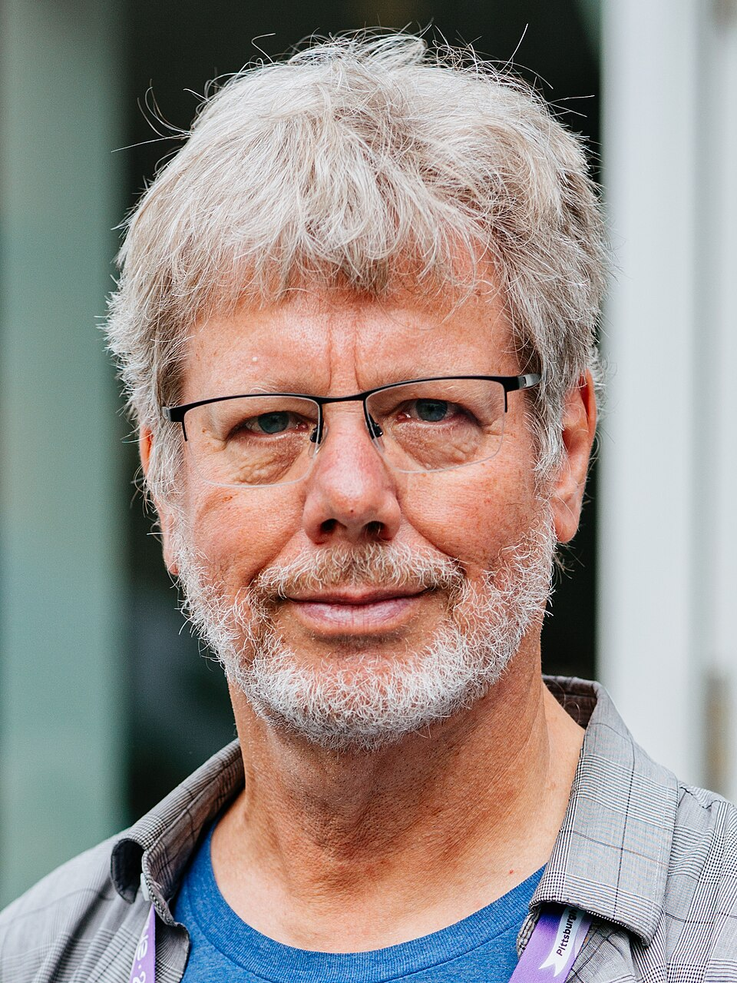
Guido van Rossum
Developed in the late 1980s by Guido van Rossum
Developed at Centrum Wiskunde & Informatica (CWI) in the Netherlands
First released in 1991.
[1]
Figure 1. Guido Van Rossum

Slide 4
The Problem
During the late 1980s, developers only had 2 choices:
Powerful programming languages like C/C++. Extremely fast and powerful, but slow to write and hard to read, highly prone to manual errors.
Shell scripts like Unix Shell. Great for quick tasks such as file management but too slow and limited for more complex logic or bigger applications.
[3]
  Which meant developers struggled with:
  Complex Syntax
  Slow development cycle
  Poor readability
  Difficult maintenance

Slide 5
Languages before Python
C (1970s)
Extremely Powerful and Fast but syntax is highly complex and manual memory management.
Modula – 3 (1980s)
Strong module system and exception handling but was “wordy” and rigid that required excessive typing for simple tasks.
ABC (1980s)
Designed for teaching. It focused on readability and clean English-like syntax but it had a closed ecosystem making it impractical for real world use. This was also developed by CWI with Guido being part of the team. This became the inspiration for Python for Guido. [1]

Slide 6
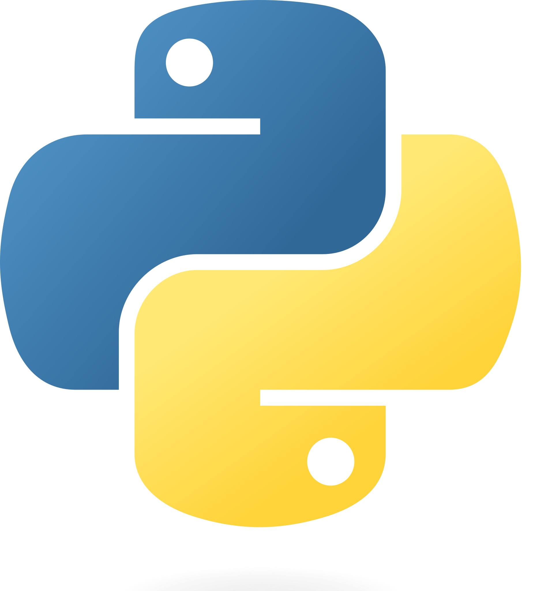
The Solution
Guido van Rossum started developing Python, December of 1989. Which was then fully released in 1991. Guido created Python by combining the best features of the programming languages at the time, while also fixing the problems that they had. [1]
Readable and user-friendly syntax from ABC.
Exception handling from Modula-3
Integrated C- for more complex logic.
Automatic garbage collection- automating the manual memory management from older programming languages.
Figure 2. Python Logo

Slide 7
Challenges faced by Python
Performance – Python being an interpreted language means it executes code line-by-line which comes at the cost of speed making it slower than compiled languages like C++.
Efficiency/Memory – Python stores metadata to make variables easy to handle but increases memory consumption. This makes Python less ideal for devices with less memory to work with such as mobile devices.
Python’s GIL- the Global Interpreter Lock was designed to ensure memory management is simple but this prevents Python from using multiple processor cores simultaneously.
Hidden Runtime Errors- Python’s dynamic typing allows for faster prototyping and development but also comes with hidden runtime errors that only appears after execution rather than being caught during development.

Slide 8
Languages Influenced by Python
Go: Designed at google for Python’s readability while having the speed of C.
JavaScript: Adopted Python’s scripting-style flexibility and clean conventions. (JS features like Async/Await and Destructuring )
Ruby: Human-centric design like Python, with the focus of ease of use for web development.
Swift: Emphasizes clean and readable syntax using expressive language, features inspired by Python’s human-centric design principles.
Kotlin- Combined Python’s concise syntax and Java’s type safety.
[2]

Slide 9
Python today
Web Development – used to build the backend, APIs and server-side applications.
Data Science – Primary tool used by data scientists/engineers for processing large datasets, predictive modelling and statistical analysis.
Machine Learning- Used in developing, training and evaluating Large Language Models and neural networks
Scientific Computing – Used in computing in engineering and science fields supporting research and simulations.

Slide 10
References
Figure 1- Kushal Das, CC BY-SA 4.0 <https://creativecommons.org/licenses/by-sa/4.0>, via Wikimedia Commons. https://commons.wikimedia.org/wiki/File:Guido_van_Rossum_in_PyConUS24.jpg
Figure 2- Logo Python, CC BY 2.5 <https://creativecommons.org/licenses/by/2.5>, via Wikimedia Commons. https://commons.wikimedia.org/wiki/File:Python-logo.png
[1]-https://en.wikipedia.org/wiki/Python_(programming_language)#:~:text=Python%20was%20conceived%20in%20the,Council%20to%20lead%20the%20project.
[2] - https://medium.com/@tellmegist/11-programming-languages-influenced-by-python-4cdab987cd4b
[3] - https://praxent.com/blog/history-of-programming-languages#:~:text=John%20McCauley%20mentioned%20shortcode%20in,++%2C%20Java%2C%20and%20Pascal.

